Slide 1
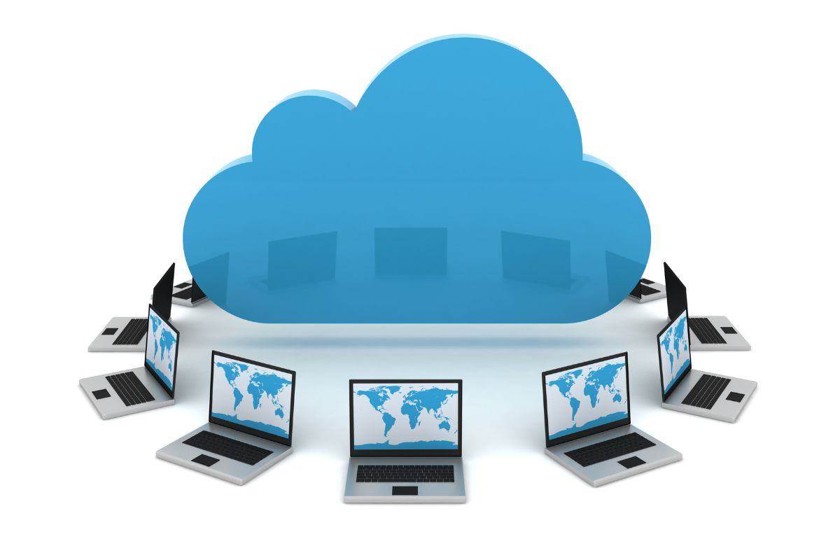
Cloud Computing
Nafisatul Hasanah, S.Kom., M.M.
FAKULTAS ILMU KOMPUTER
PROGRAM SARJANA TEKNOLOGI INFORMASI

Slide 2
Learning Objectives
Basic concept of cloud computing
Development of cloud computing

Slide 3
Intoduction
VIDEO (LINK)

Slide 4
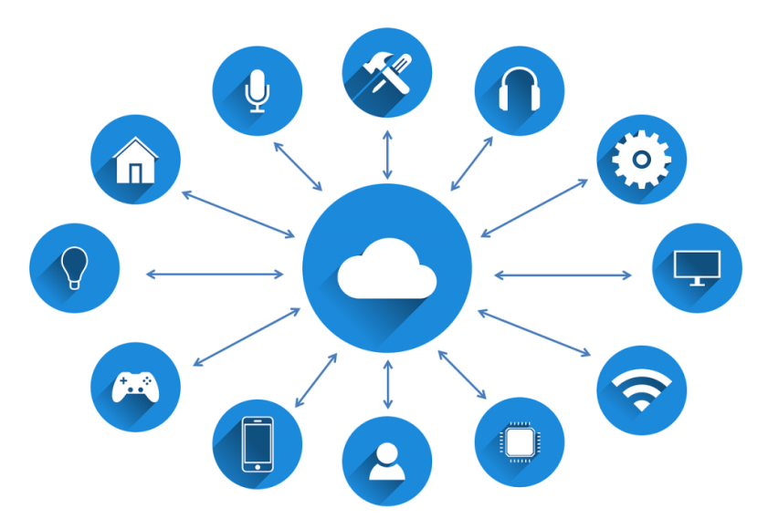
Cloud computing definition
Cloud Computing is the process of processing computing power (both CPU, RAM, Network Speeds, Software, OS and Storage) over a network (usually via the internet). So the data transfer that occurs is not physical and the computing resources owned are located at the location of the user who uses the service.

Slide 5
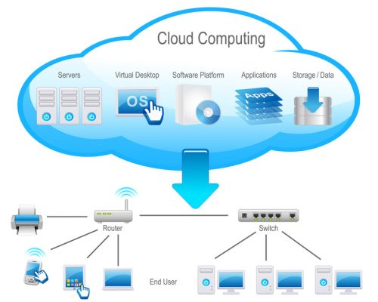
Cloud computing principle
Cloud computing systems work online and continuously without stopping via the internet network.
All activities will be centered on the server computer and every type of data will be directly stored and ready to use at any time.

Slide 6
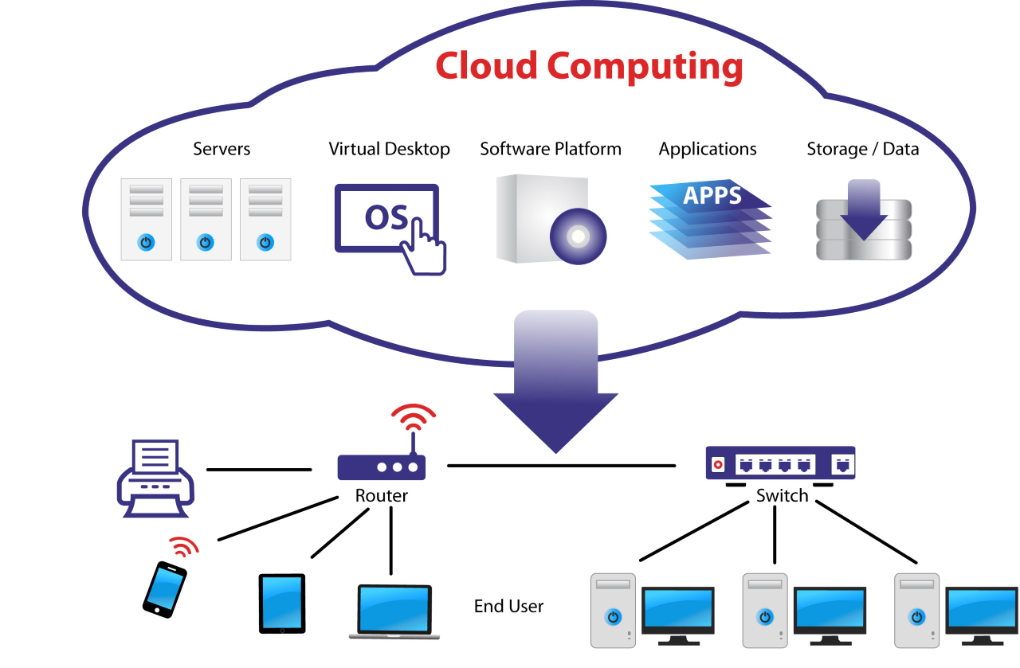
Cloud computing fundamental
Notes:
https://codecoda.com/en/blog/entry/understanding-the-fundamentals-of-a-cloud-computing-architecture

Slide 7
Cloud computing fundamental
Virtualization – This involves the virtual representation of physical resources such as servers or storage. This virtualization of resources is employed in building cloud networks and enables the utilization of the same physical resources by multiple applications. This increases the efficiency of networking, storage, and servers throughout the establishment.
Infrastructure – These include all the physical components of data centers such as servers, storage, and networking gear such as routers and switches, etc.
Middleware - These are software components that enable networked software, applications, and computers to communicate with each other. Examples of middleware include databases and communication applications.

Slide 8
Cloud computing fundamental
3. Management – These are tools that are used to continually monitor the performance and capacity of a cloud environment. These tools allow the tracking, usage, integration, deployment of new apps, and data recovery in the cloud environment, all from one console.
4. Automation software – When there are situations such as a rise in the need for computing power or fluctuating market demands, automation can be employed to scale up the system resources to accommodate the spike, deploy applications, and can even be used for proper governance in a cloud system. Automation of IT services lessens the workload, reduces costs, and allows for streamlining of application delivery.

Slide 9
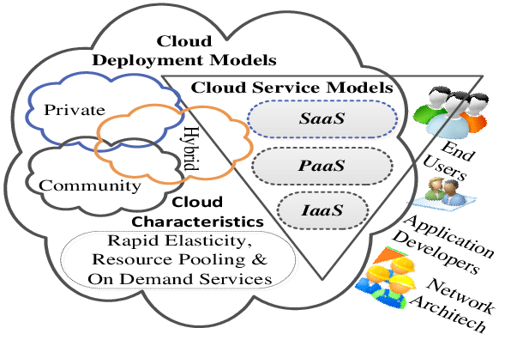
Cloud computing Architecture

Slide 10
Cloud computing deployment models
Public cloud – Here, the cloud service provider owns and runs the computing resources, which they share and redistribute across several tenants through the internet. Advantages include reduced operating cost, little or no maintenance, and easy scalability.
Private cloud – in this model, the cloud is owned and managed by a private establishment, usually in their on-premise data center. However, the servers can be located in several server locations scattered geographically. This model is more expensive than the public model but offers more stringent data security and compliance options and is more customizable.

Slide 11
Cloud computing deployment models
3. Hybrid cloud – This combines both the public and private models, thus incorporating the operating efficiencies of the public model into the data security feature of the private model. This combination helps the consolidation of IT resources and shifting workloads by organizations, between different environments depending on the data security and IT requirements.
4. Multi-cloud – A multi-cloud cloud architecture uses several public cloud services. This gives the organization the ability to choose the cloud service option that best suits their organizational needs This model also allows the organization to rely less on a single cloud service vendor. Thus, increasing cost savings and reducing vendor lock-in likelihood. Also, this model can be used to support services that exist on multiple clouds, such as microservices-based containerized applications.

Slide 12
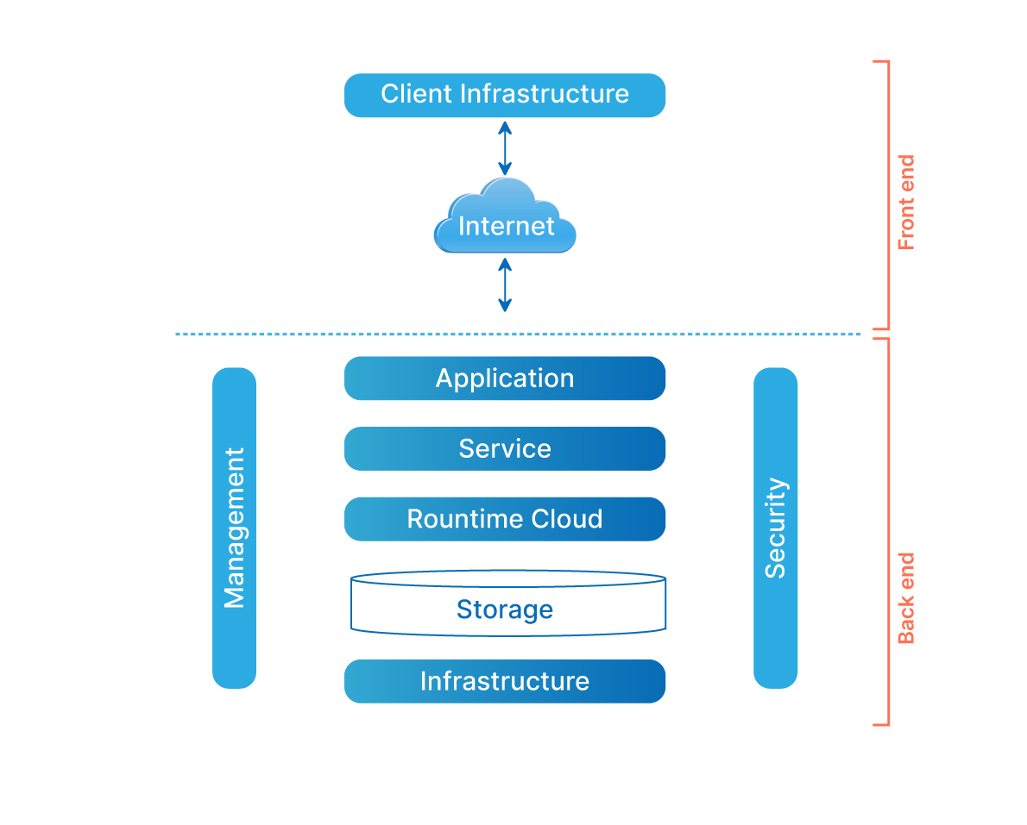
Cloud computing architecture
Notes:
https://www.shiksha.com/online-courses/articles/cloud-computing-architecture-advantages-and-disadvantages/

Slide 13
Cloud computing architecture
Client infrastructure: The client infrastructure component is a frontend component that provides a graphical user interface (GUI) for users to interact with the cloud.
Application: An application is any platform, such as an app or software, provided by a company through which clients can access the cloud.
Service: A cloud service manages the type of service a client uses based on his needs. There are three types of services: SaaS (software as a service), PaaS (platform as a service), and IaaS (infrastructure as a service).
Runtime cloud: The runtime cloud offers virtual machine implementation and runtime environment.

Slide 14
Cloud computing architecture
5. Storage: The cloud computing storage component provides storage space in the cloud for managing and storing data. Cloud storage is of three types: public cloud, private cloud, and hybrid cloud.
6. Infrastructure: The infrastructure component provides services on three levels: the host, the application, and the network. It includes the software and hardware components required to support the cloud computing model, such as storage network devices, servers, and other storage resources.
7. Management: The management component is in charge of managing backend components such as storage services, applications, runtime cloud infrastructure, and security issues, as well as establishing coordination.
8. Security: Security is the backend component of cloud computing that ensures data security in the cloud.
9. Internet: The internet is the medium through which the frontend and backend components communicate and interact.

Slide 15
Advantages of Cloud Computing
All Data Stored on Server Centrally
Data Security
High Flexibility and Scalability
Long Term Investment

Slide 16
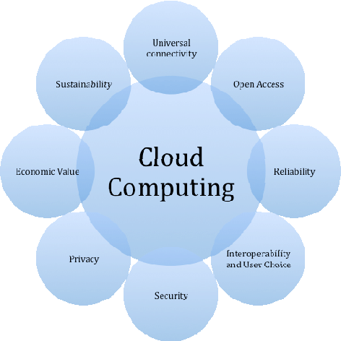
Advantages of Cloud Computing

Slide 17
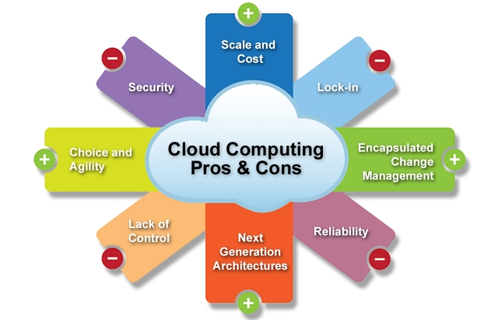
Cloud Computing Issues
Notes:
References: https://www.cloudcomputingfundamentals.com/cloud-issues-you-should-be-aware-of/

Slide 18
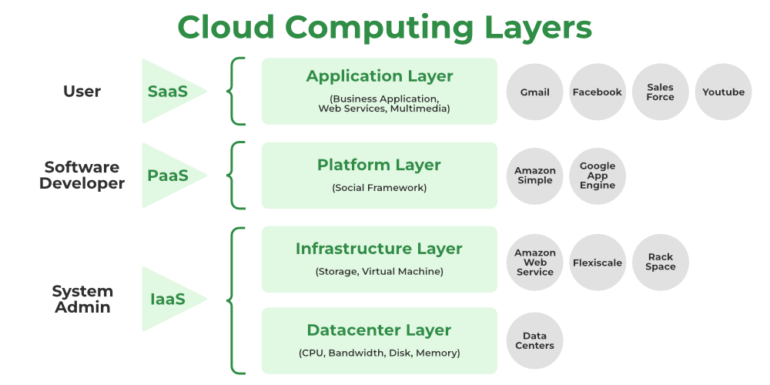

Slide 19
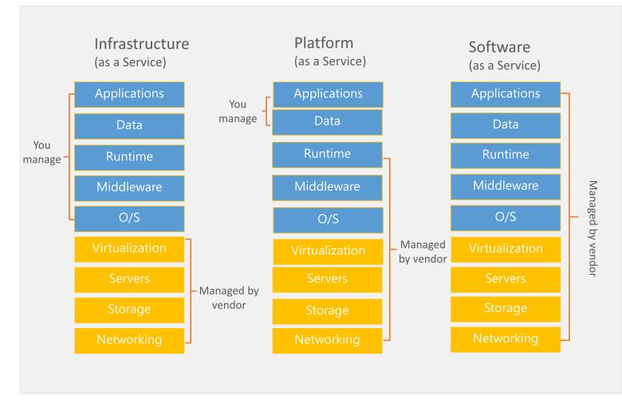

Slide 20
Type of service
1. SAAS (Software as a Service)
This type of service provides ready-to-use applications intended for end users. So that users no longer need to create new applications.
Examples of SAAS services are Gmail, Twitter, Facebook, and so on. In these services, anyone can use them for various purposes without having to bother building new servers or infrastructure.

Slide 21



SAAS (Software as a Service)

Slide 22
Type of service
2. PAAS (Platform as a Service)
Layanan PAAS berfungsi untuk menyewakan tempat kepada para pengguna aplikasi untuk menjalankan aplikasi tersebut. Contohnya ialah seperti penyediaan database, framework, atau sistem operasi lainnya yang merupakan suatu platform untuk menjalankan aplikasi.
Beberapa layanan yang menyediakan PAAS diantaranya seperti Amazon Web Service, Windows Azure, dan Google App Engine.

Slide 23
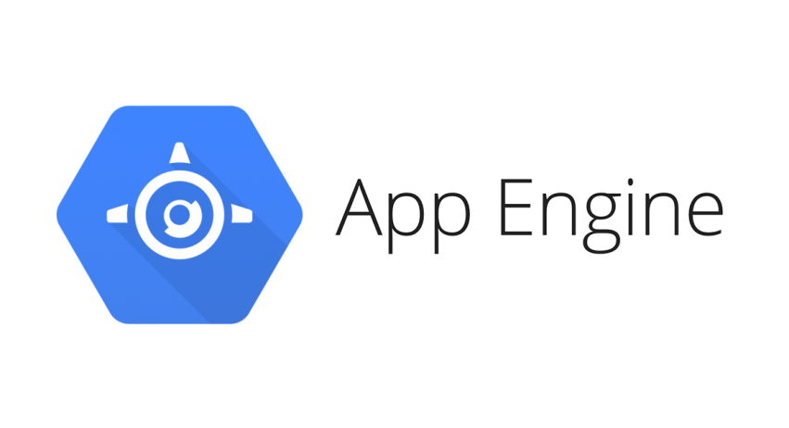
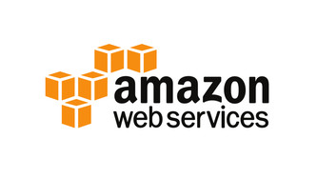
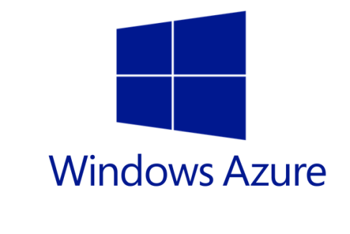
PAAS (Platform as a Service)
Some services that provide PAAS include Amazon Web Service, Windows Azure, and App Egine

Slide 24
Type of service
3. IAAS (Infrastructure as a Service)
This service provides IT infrastructure for end users which in the service is based on cloud data. The infrastructure provided can be hardware such as memory, hard disk, or certain types of servers.

Slide 25
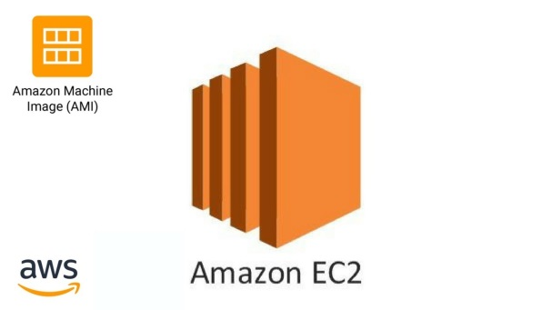
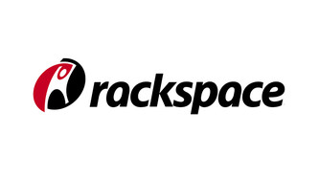
IAAS (Infrastructure as a Service)
Examples of IAAS service providers include Rackspace cloud, Amazon EC2, and so on.

Slide 26
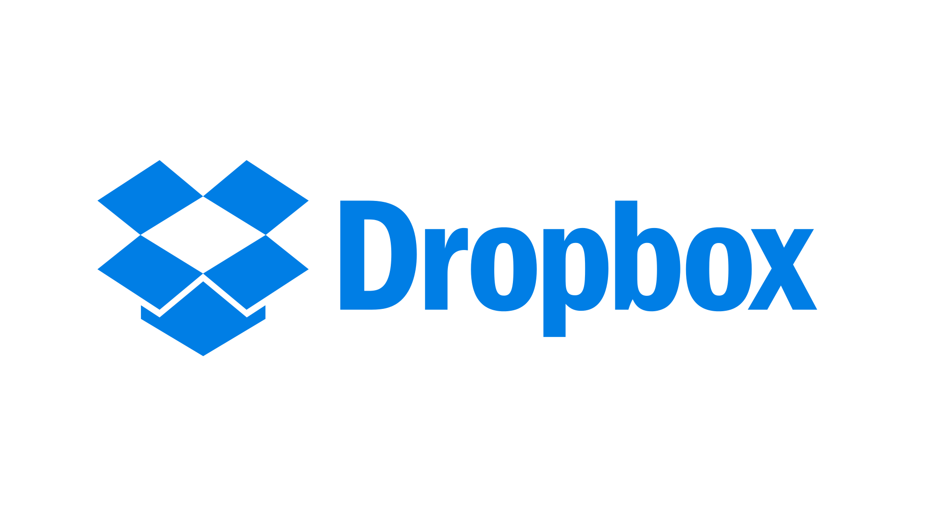

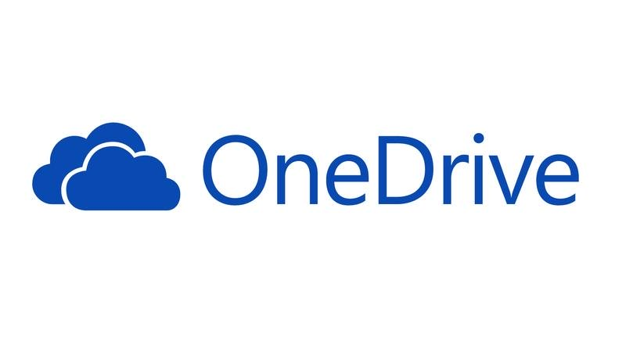
Cloud Computing:
Google Drive
One Drive
Dropbox

Slide 27
THANK YOU

